Slide 1

Notes:
Hey everybody, thanks for being here. I’m Chris Foti with Next Level Property Management. Quick heads up before we jump in: everything today is education, not legal advice. If you’ve got a specific case, run it by your attorney. Here’s the plan. We’ll hit the basics of evictions, then extended stays, then evictions tied to criminal activity. After that, what we’re seeing in the market and what changed at the legislature. At the end, the Washoe County deputy is going to take your lockout questions. I’m going to move fast, so if something comes up, hang onto it for the Q&A. Let’s get into it.

Slide 2
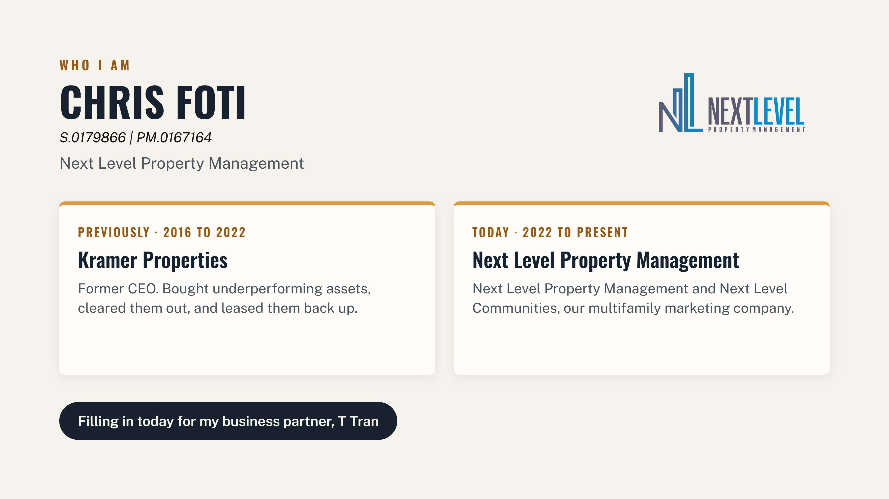

Slide 3
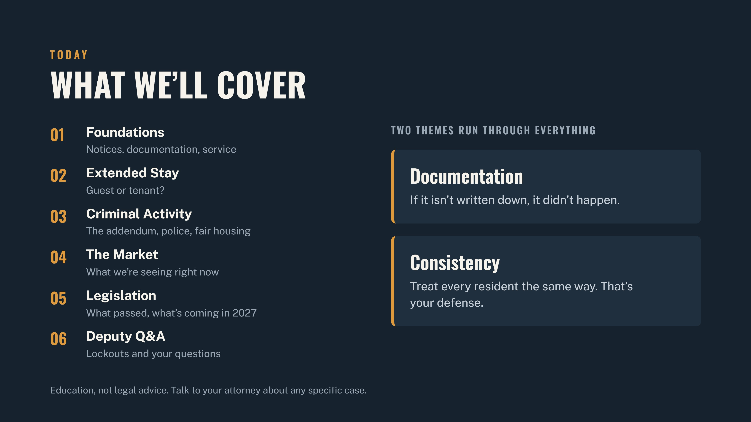

Slide 4
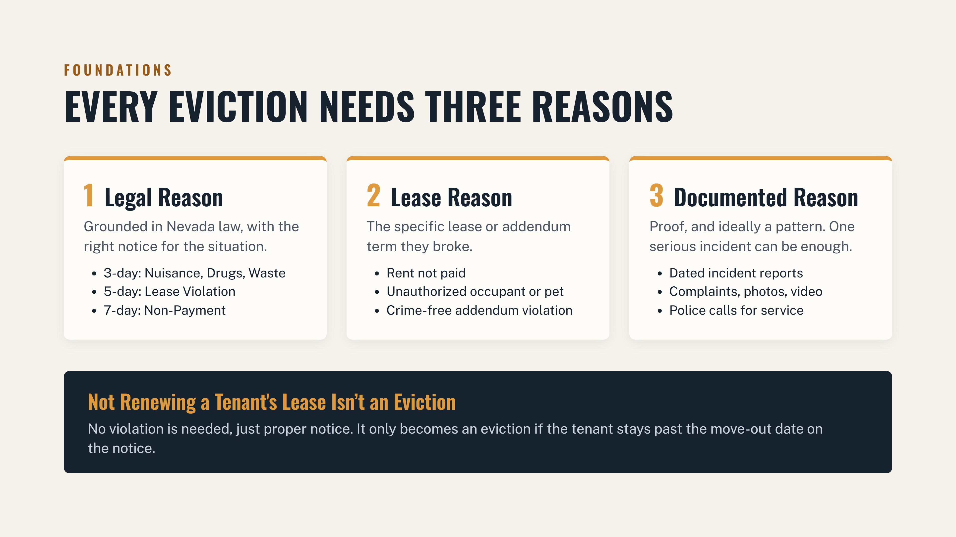

Slide 5
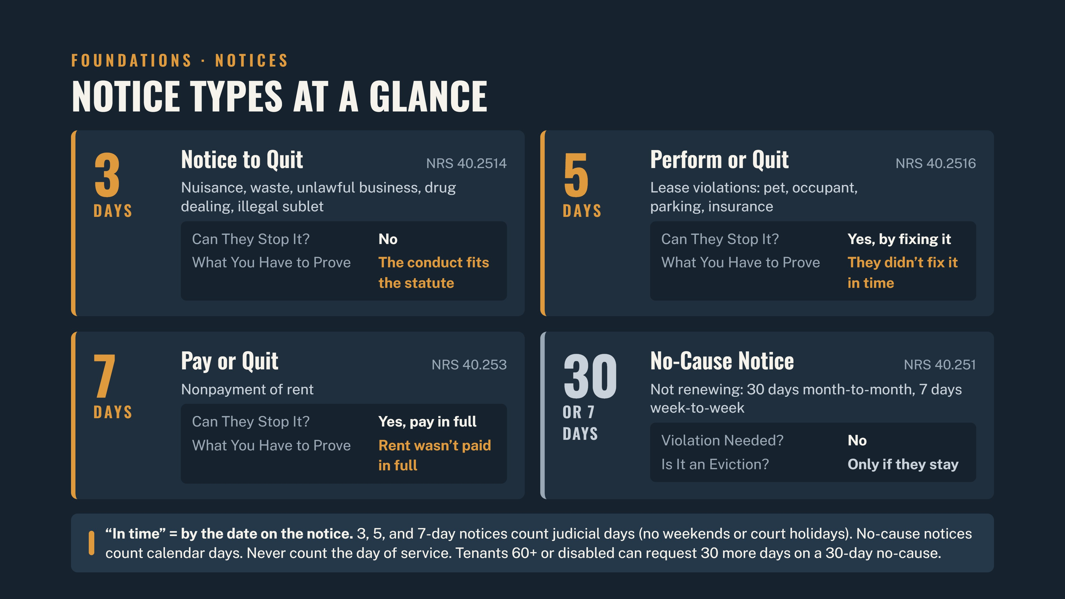

Slide 6
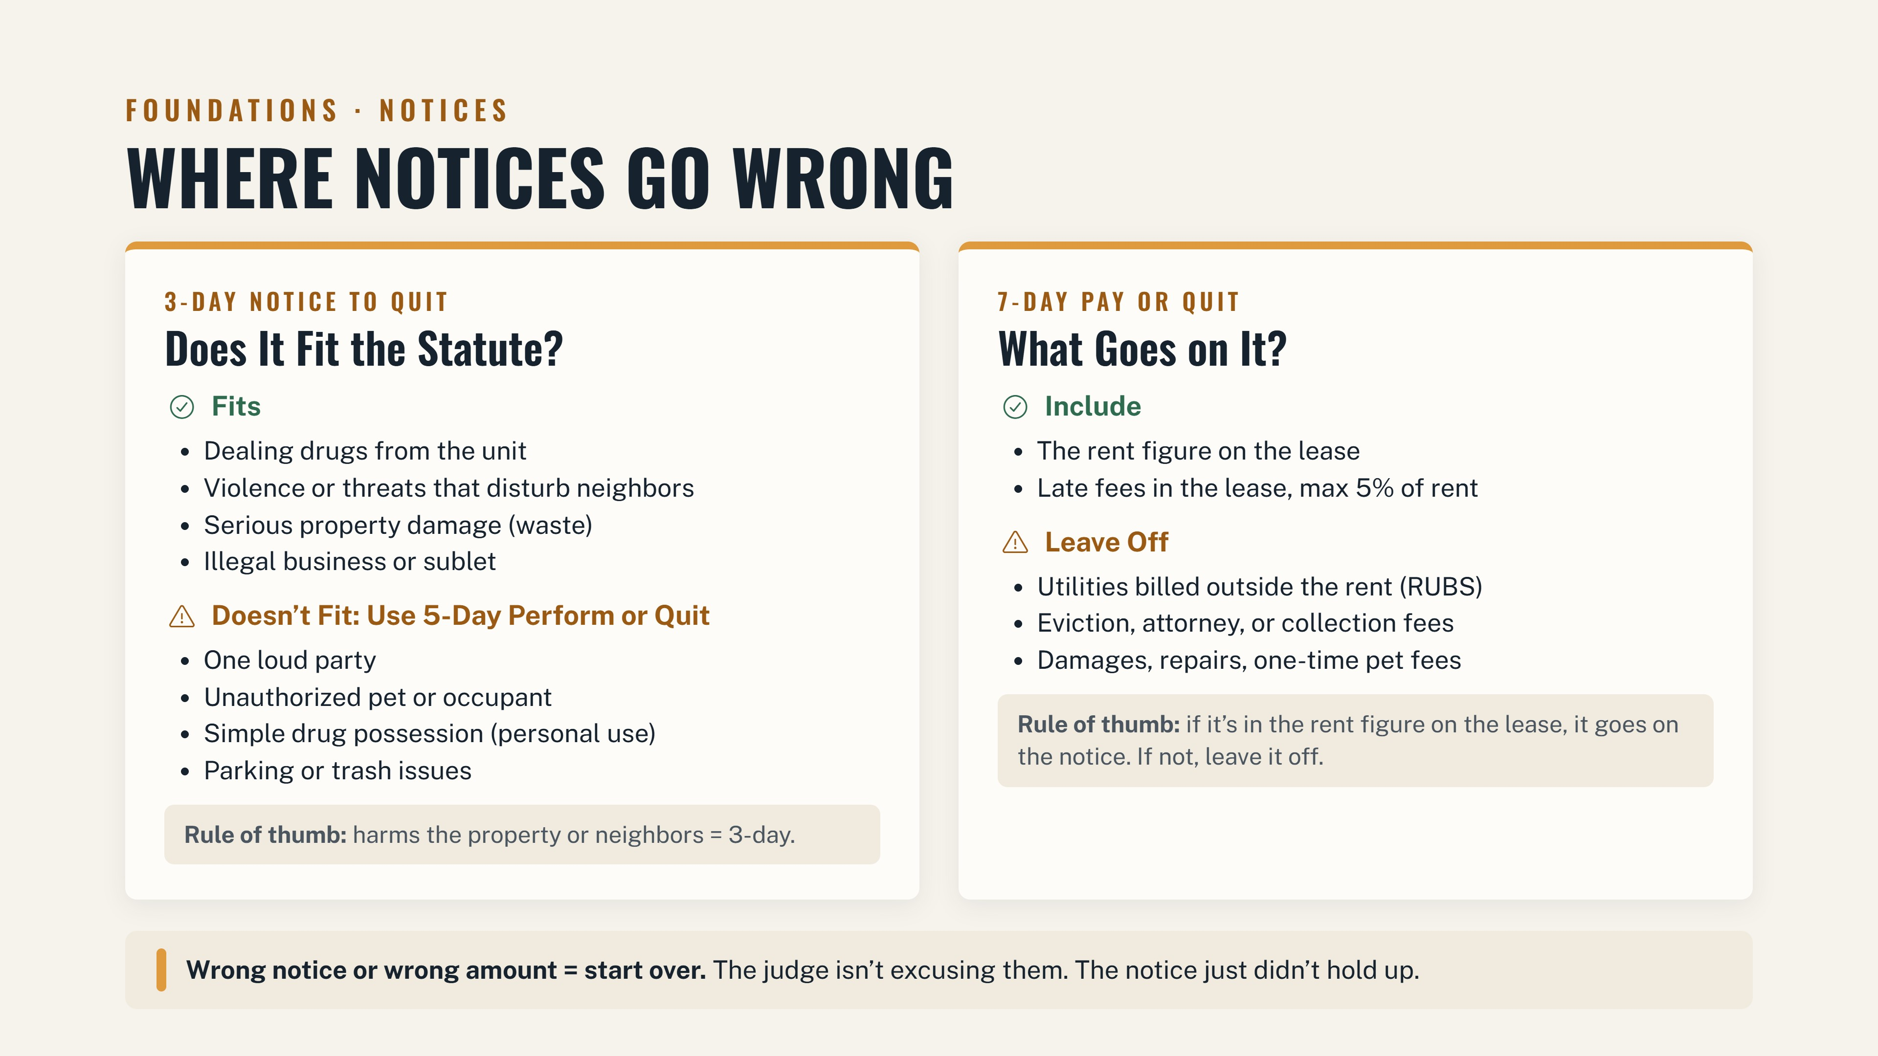

Slide 7
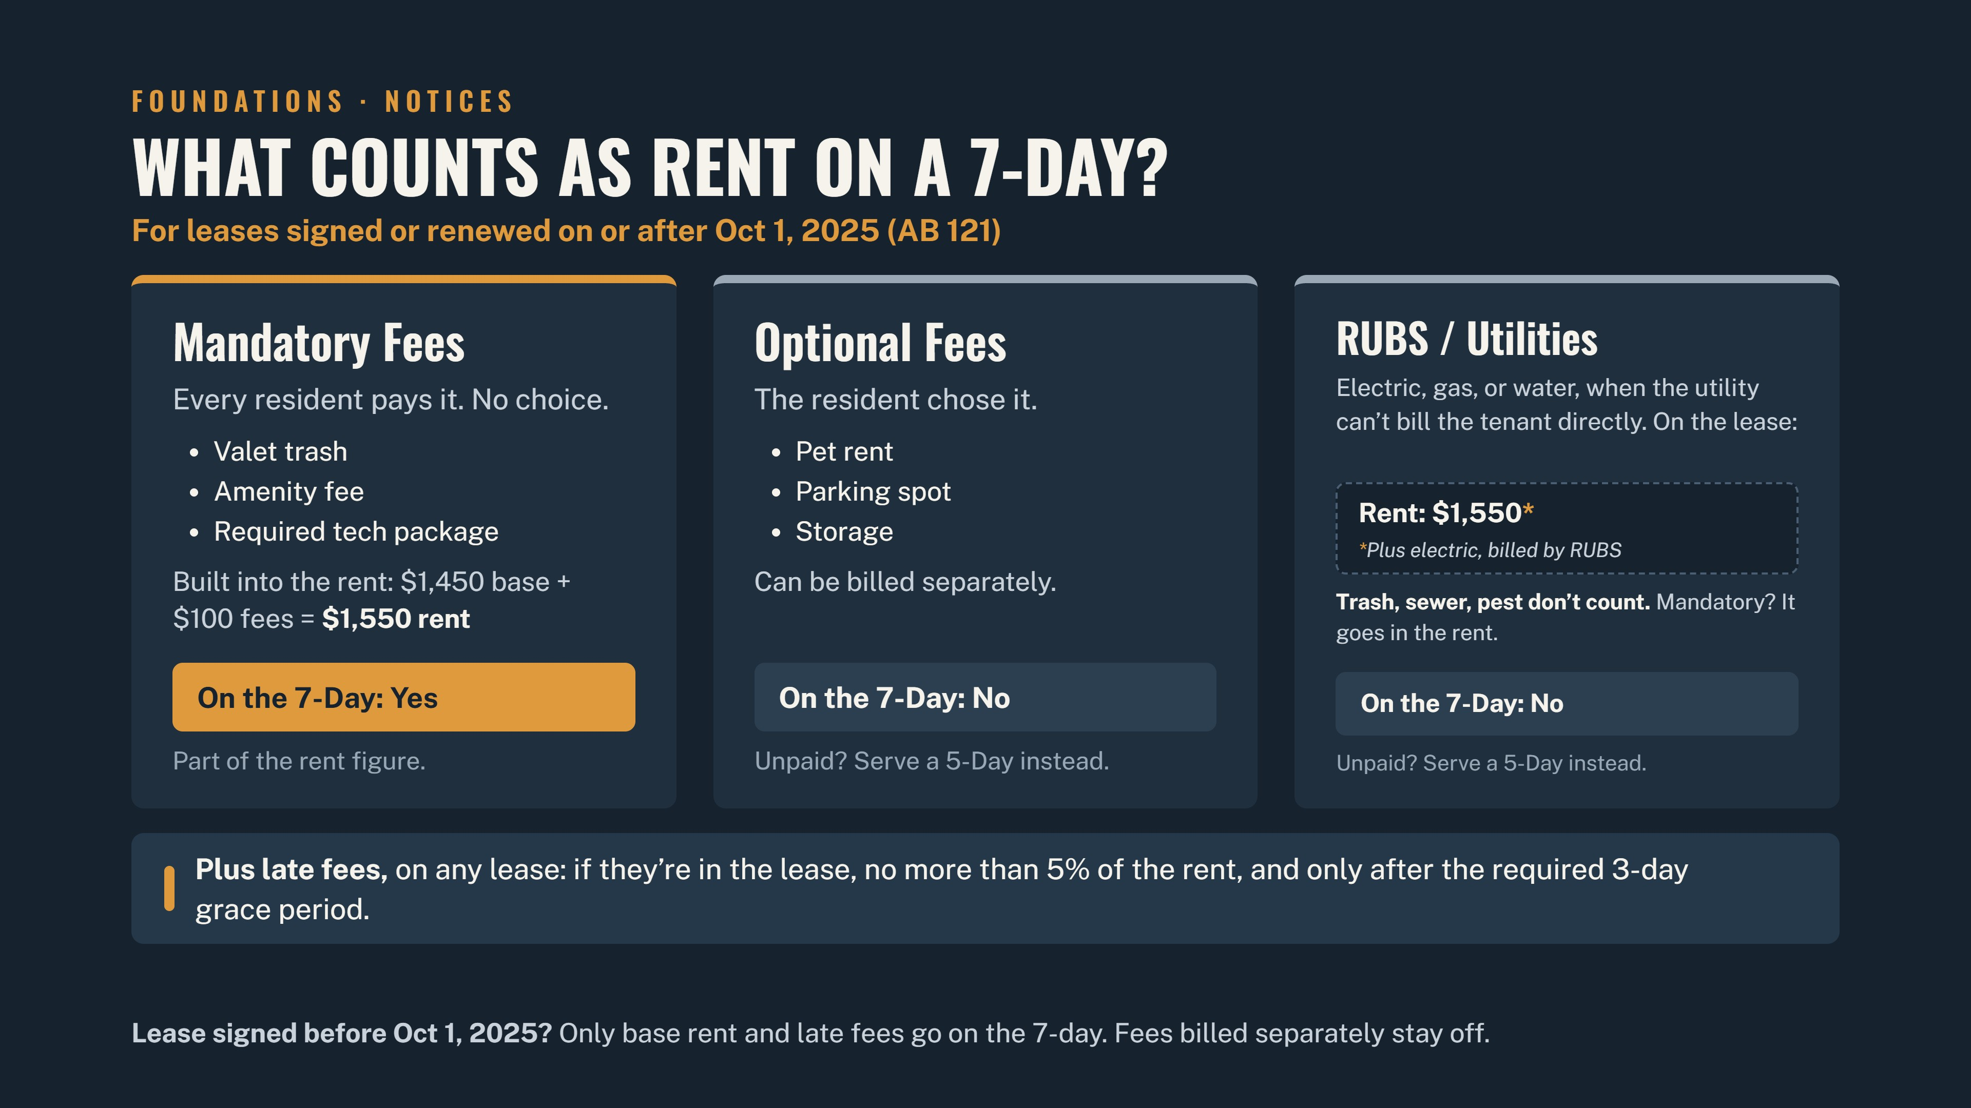

Slide 8
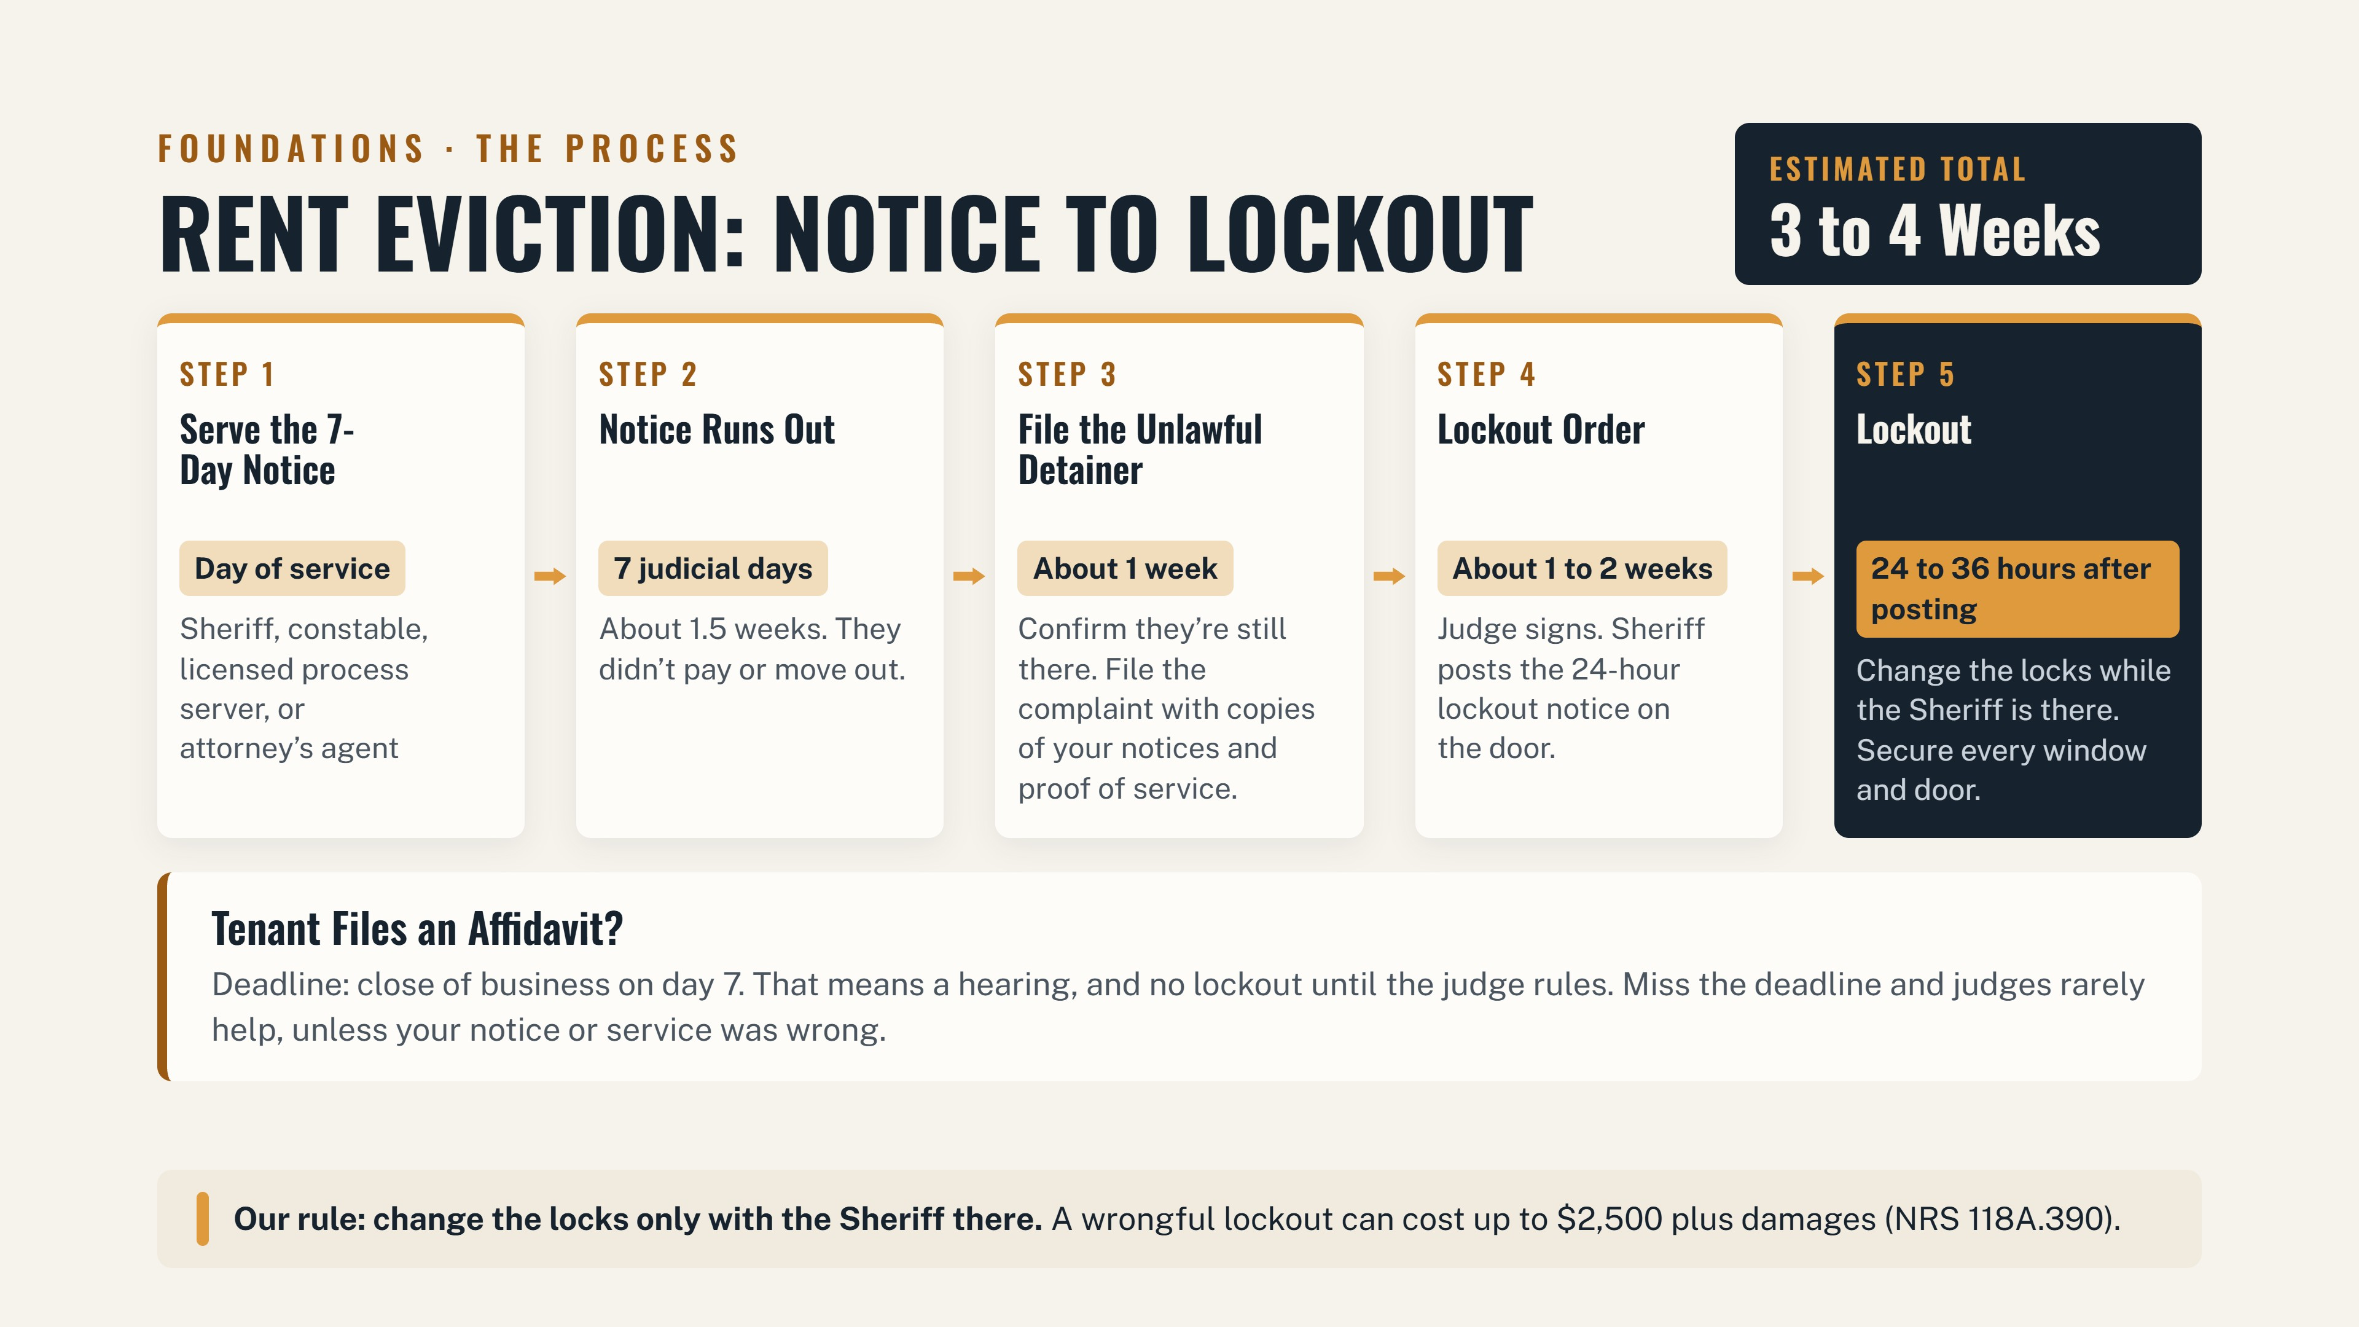

Slide 9
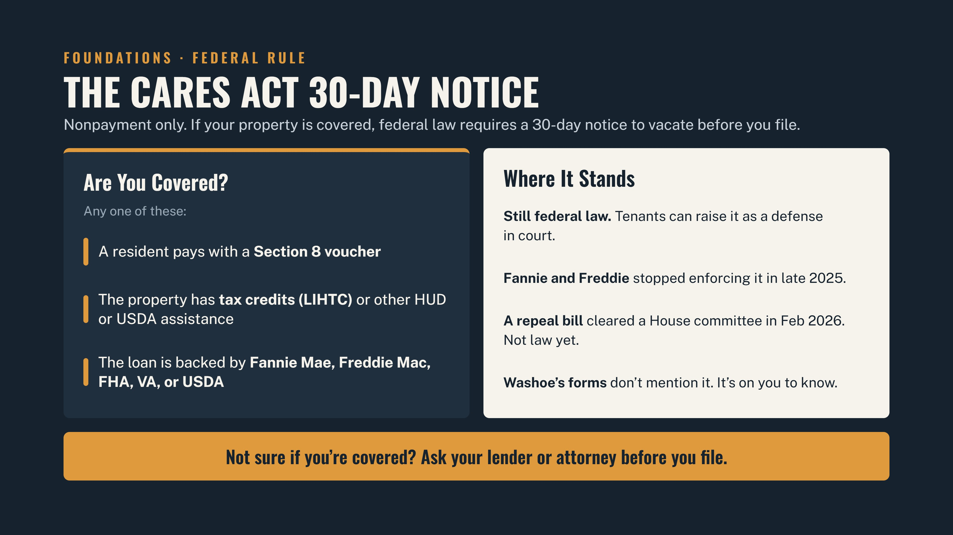

Slide 10
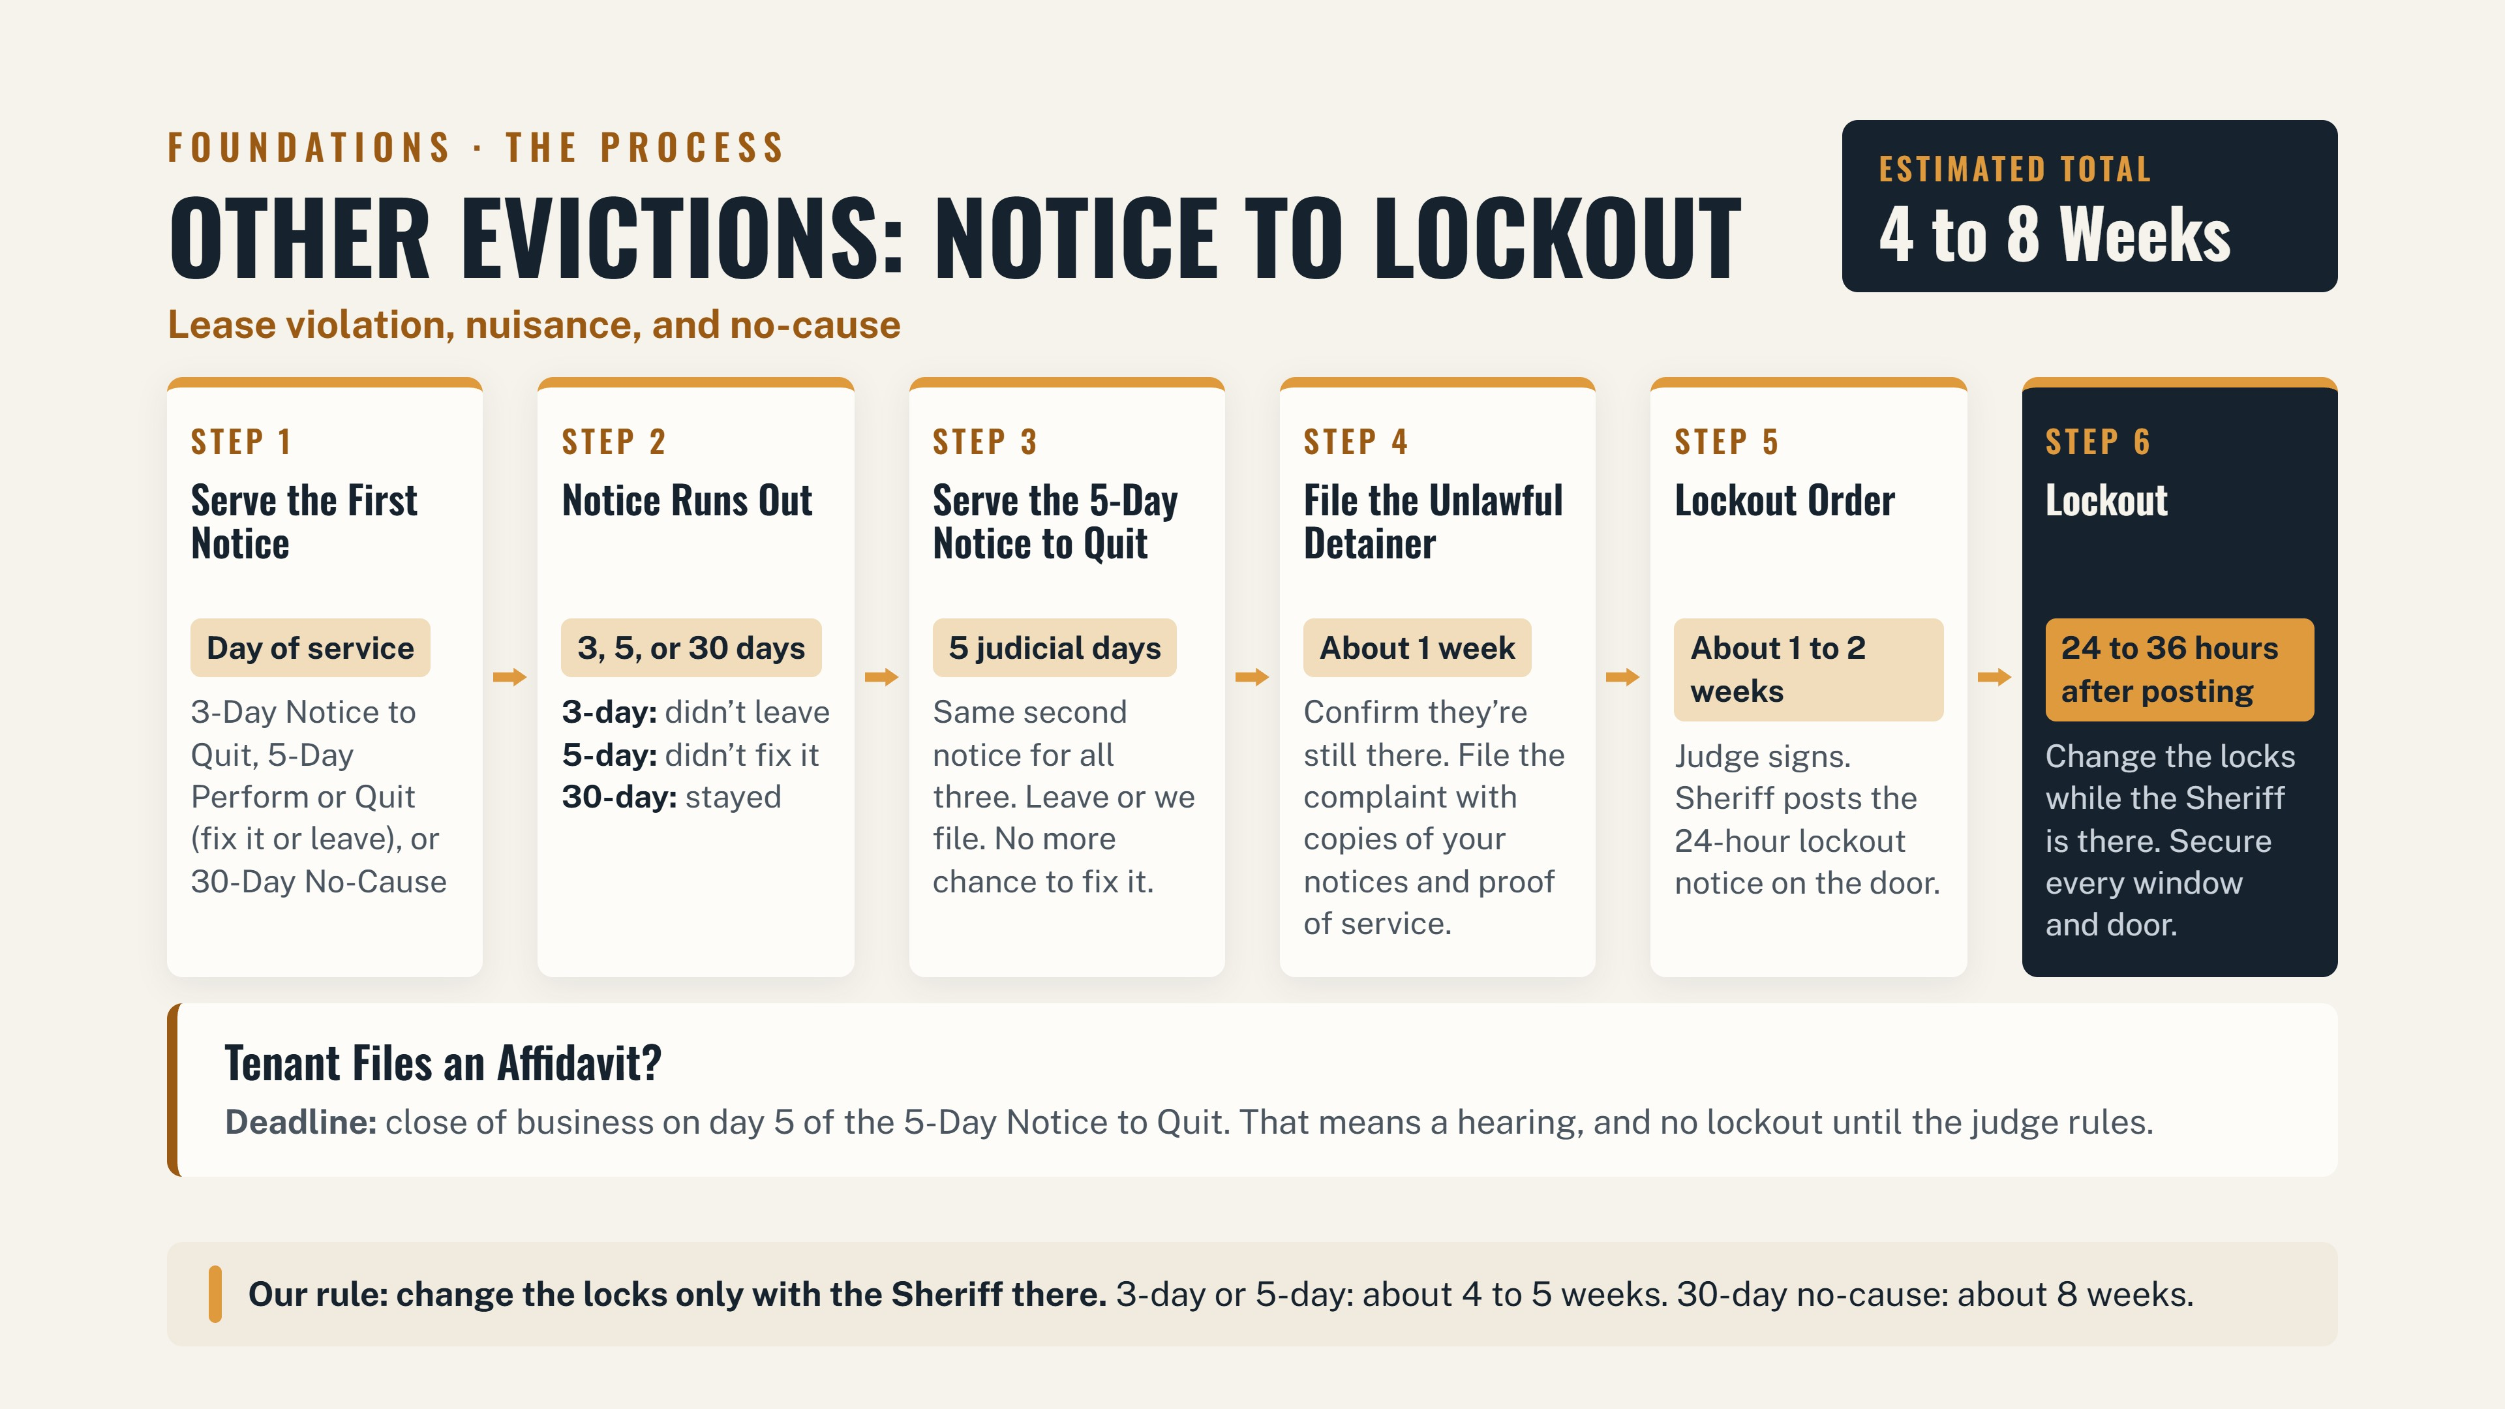

Slide 11
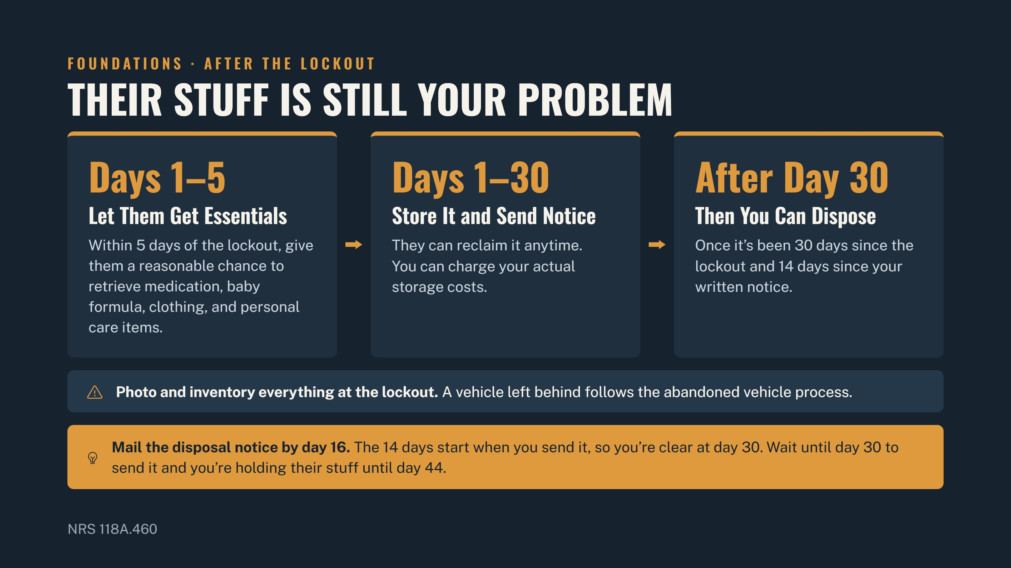

Slide 12
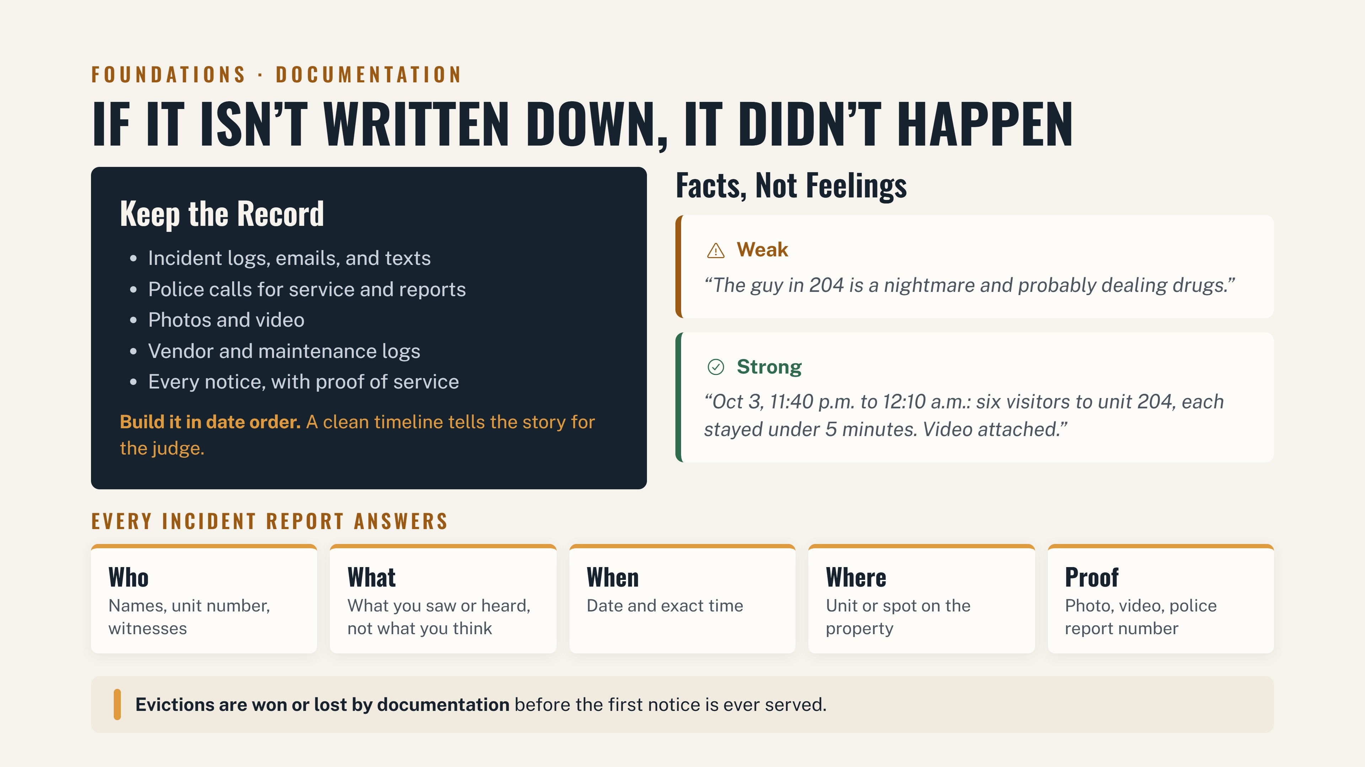

Slide 13
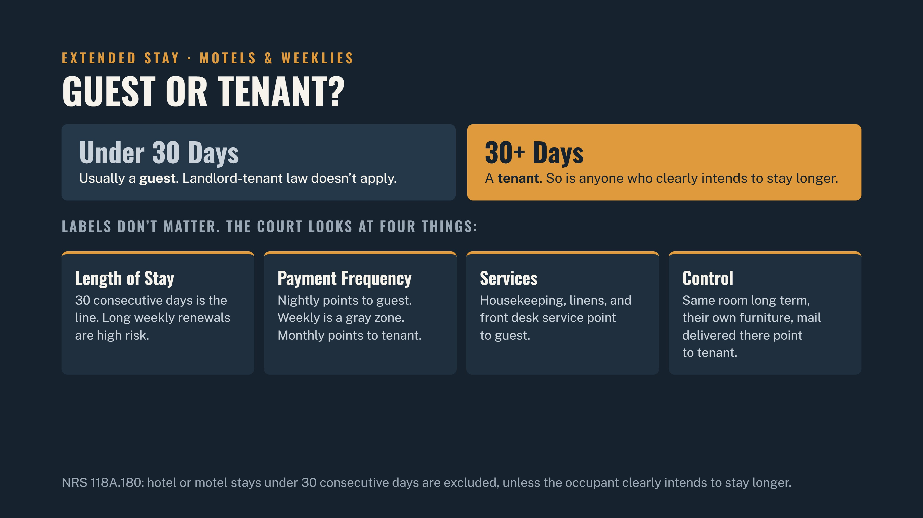

Slide 14
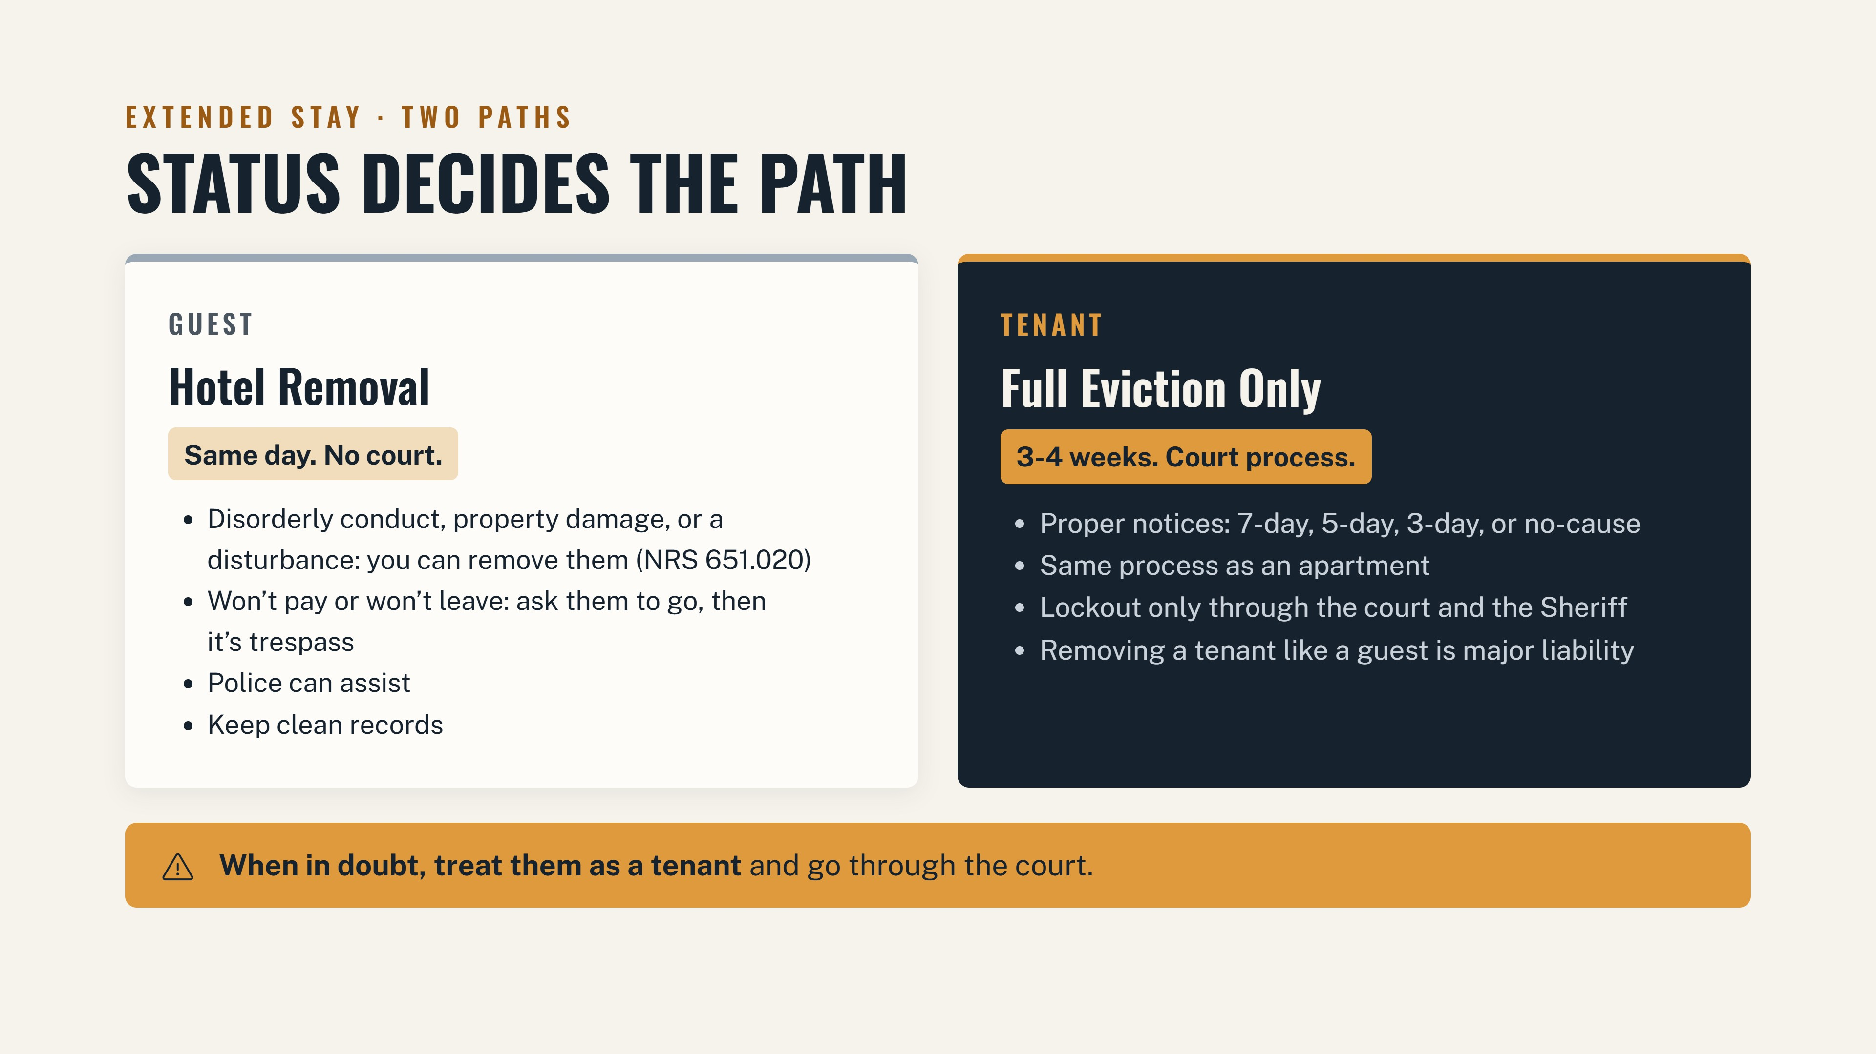

Slide 15
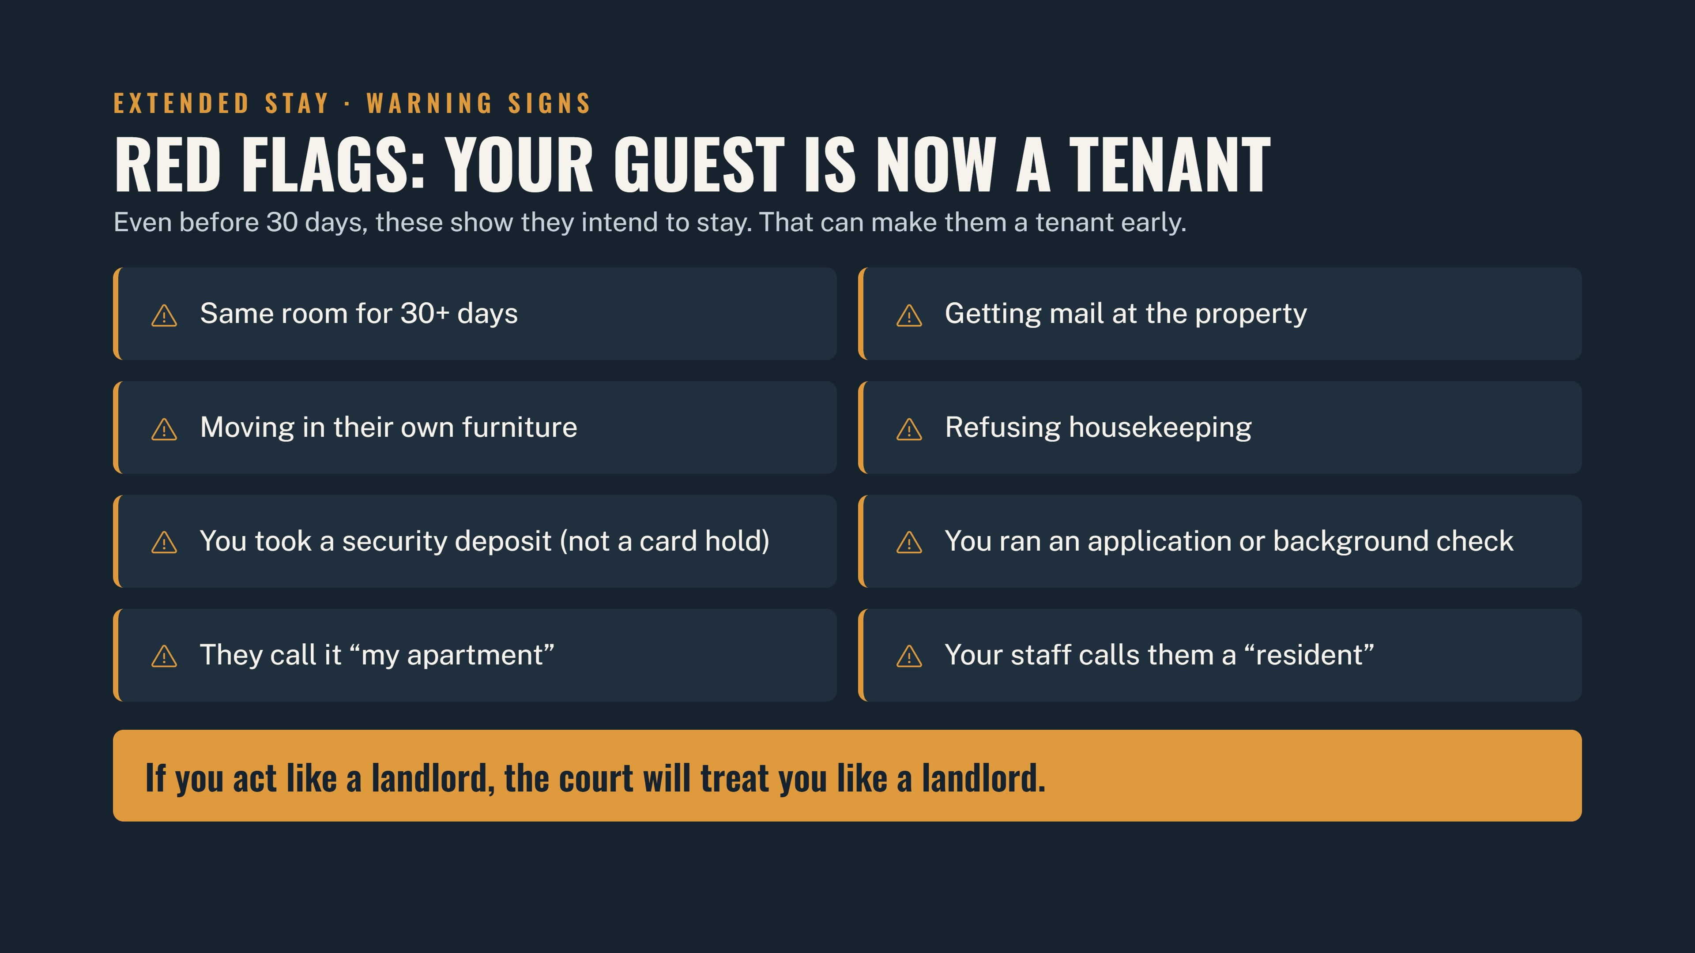

Slide 16
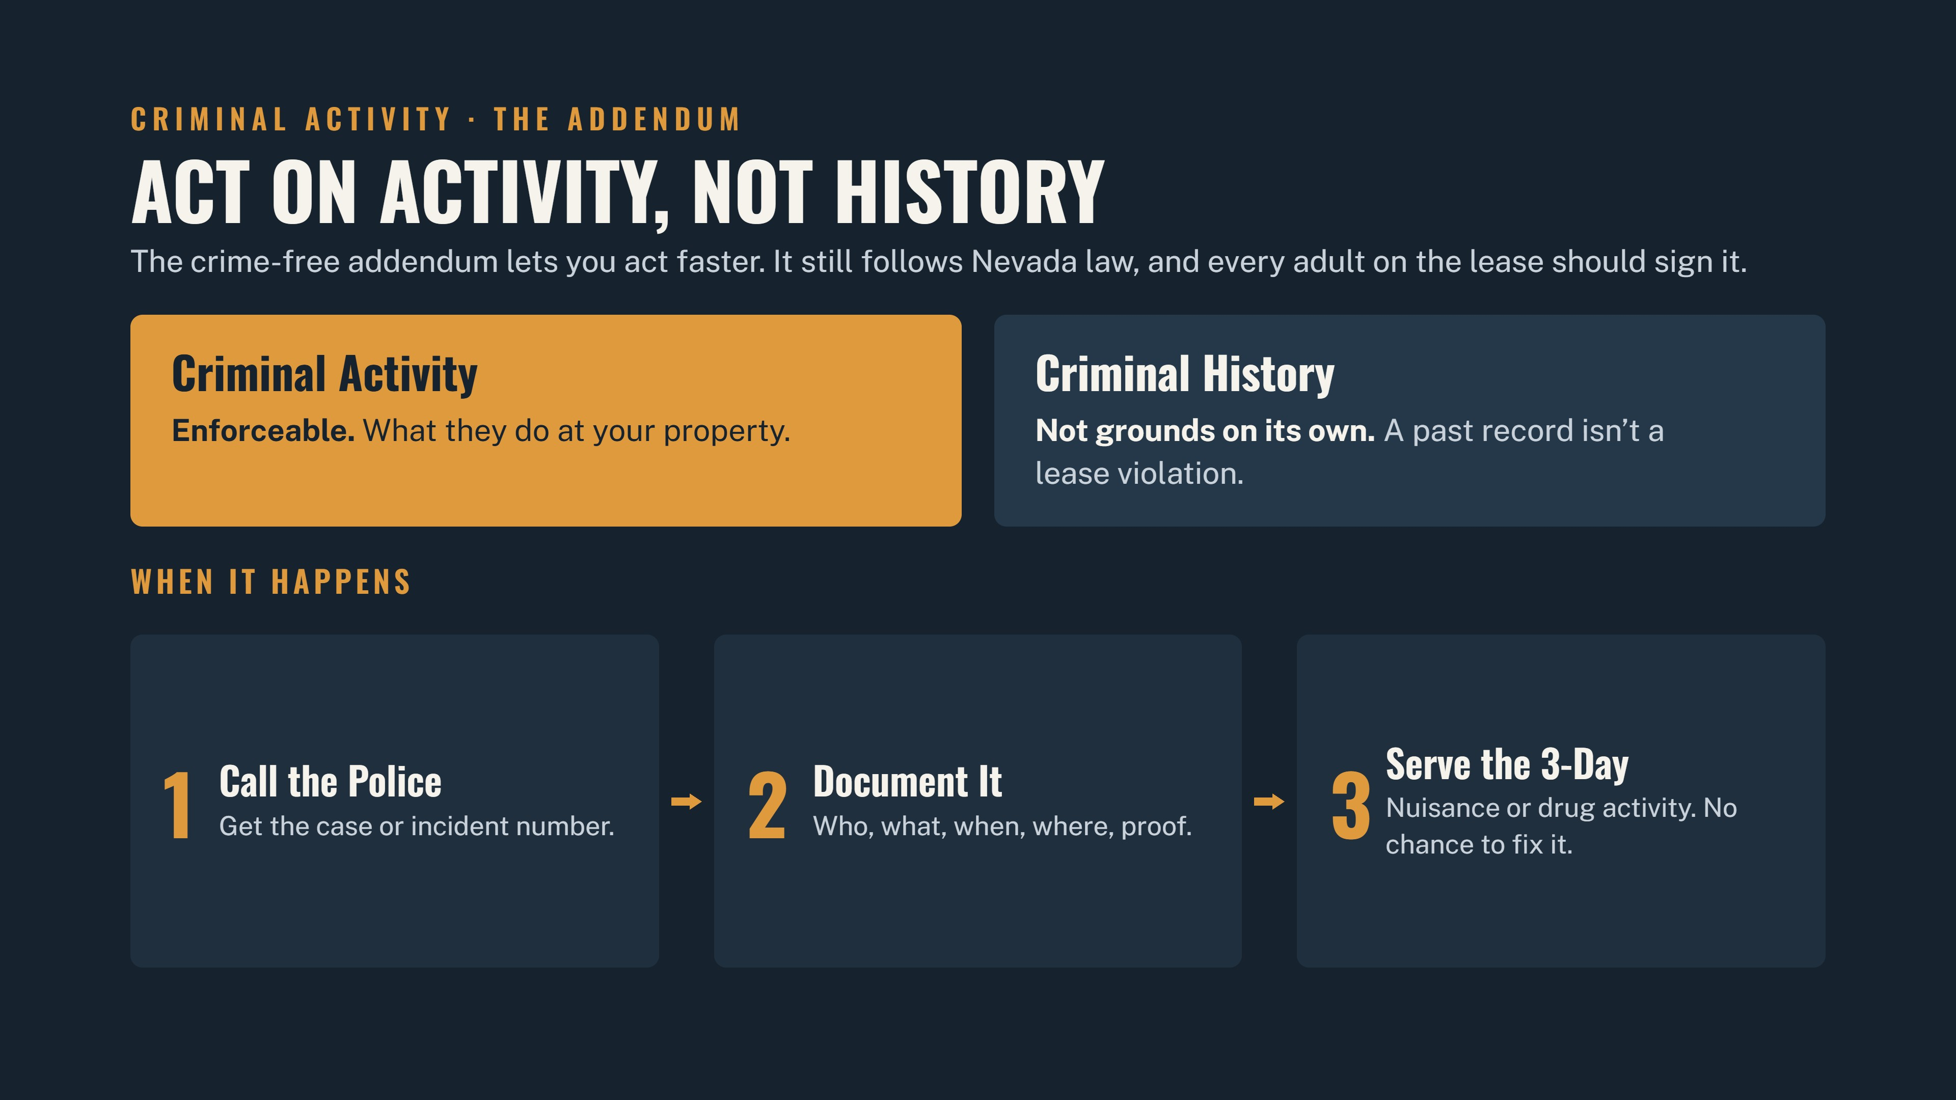

Slide 17
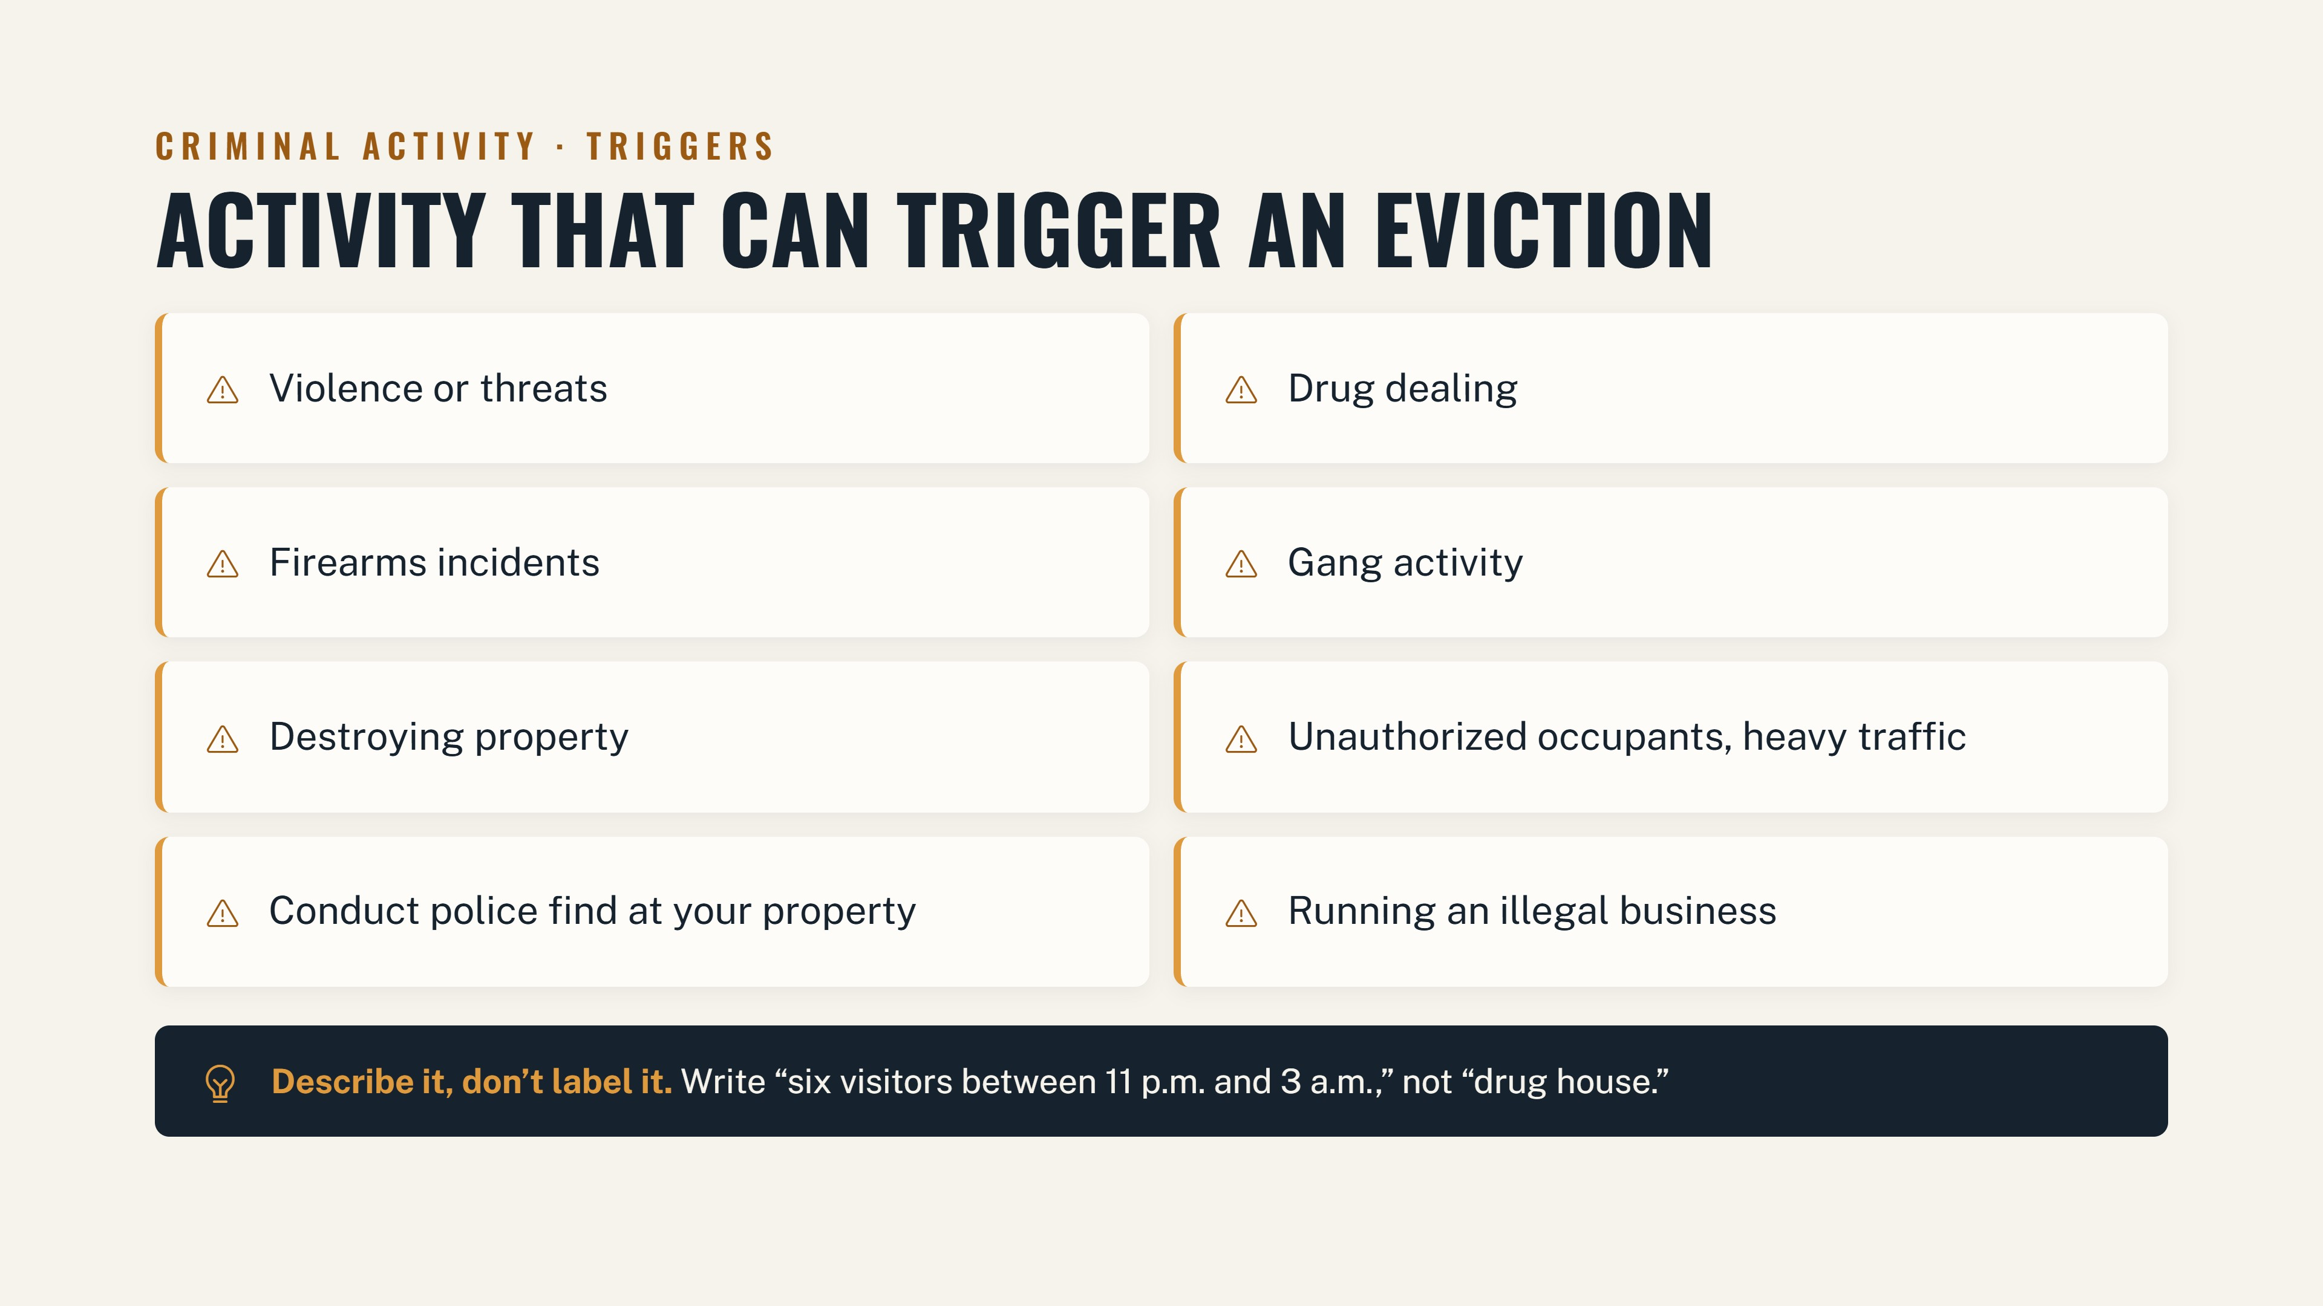

Slide 18
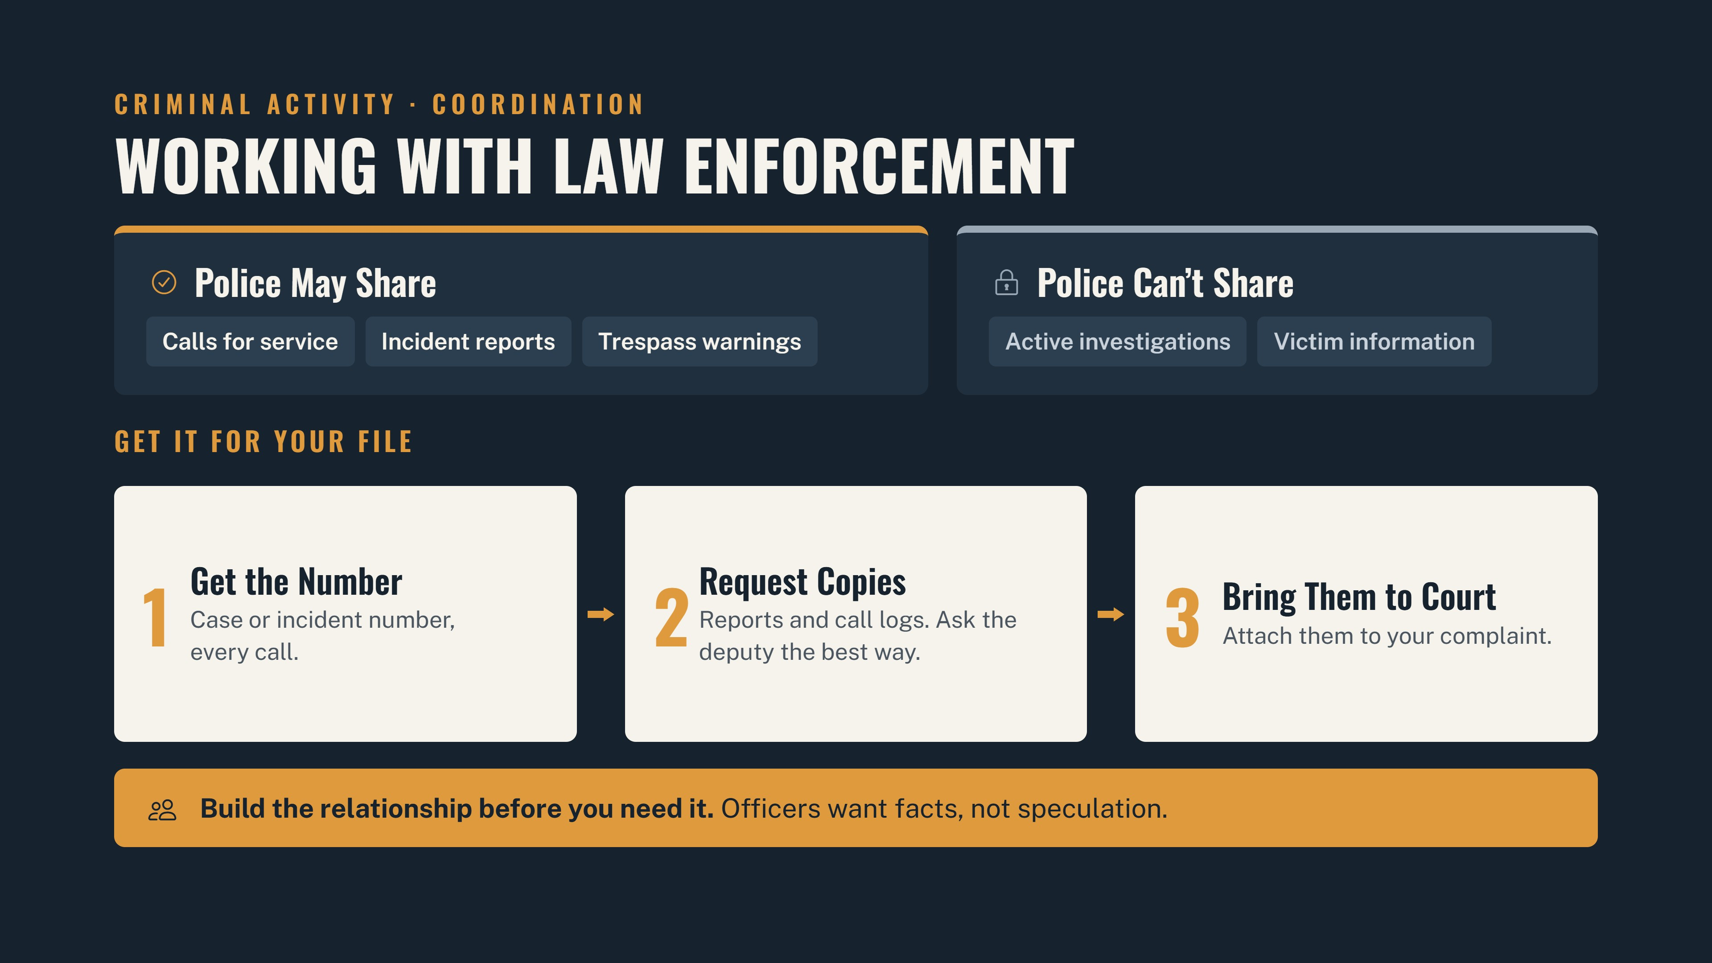

Slide 19
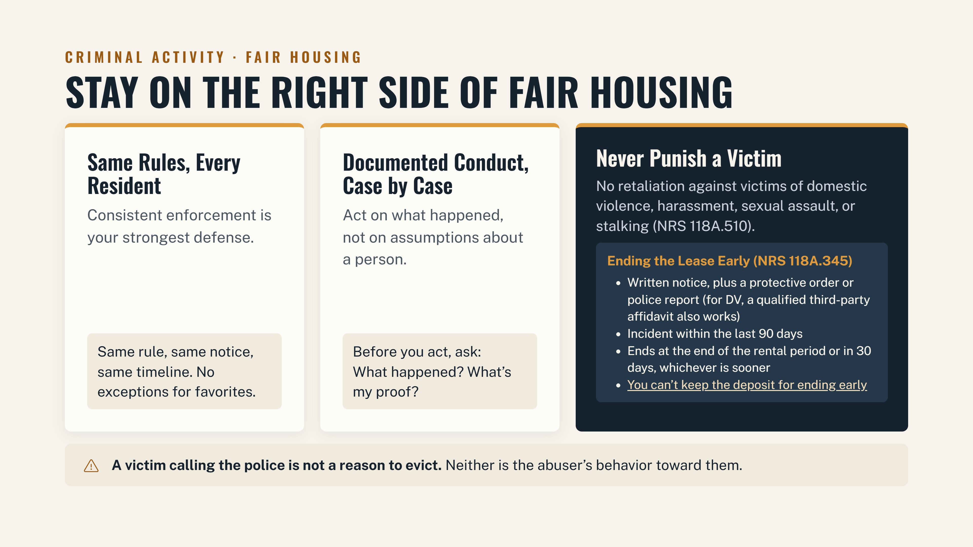

Slide 20
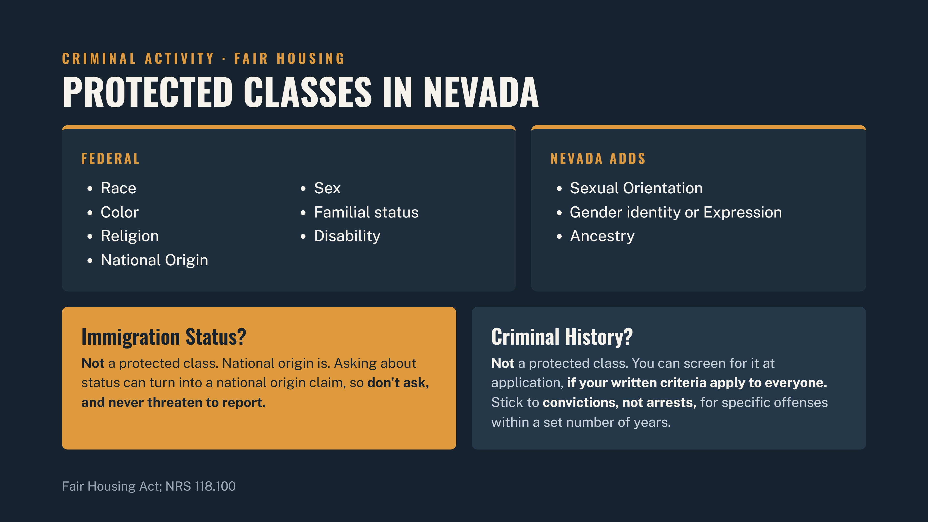

Slide 21
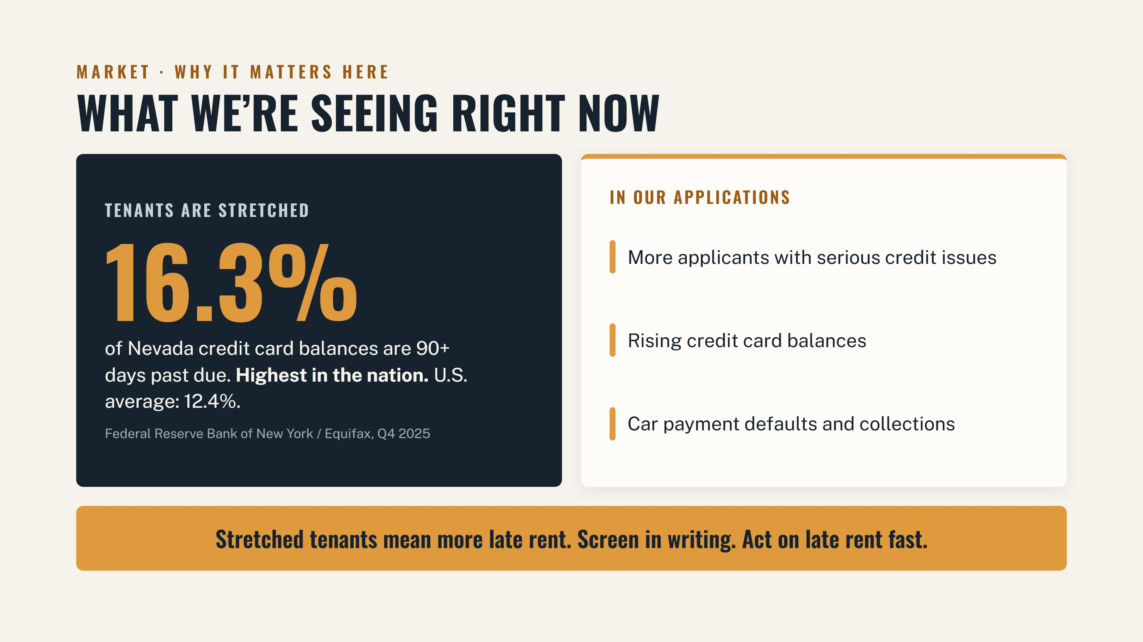

Slide 22
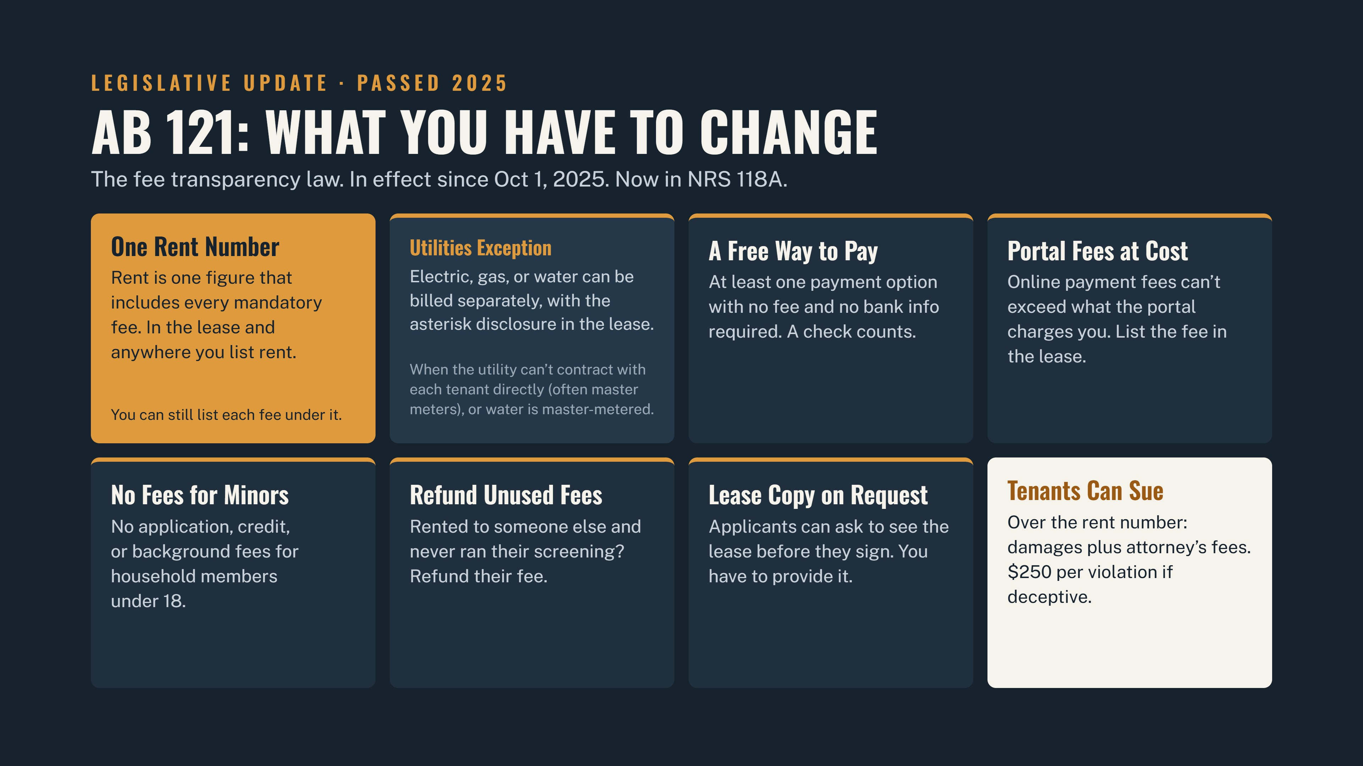

Slide 23
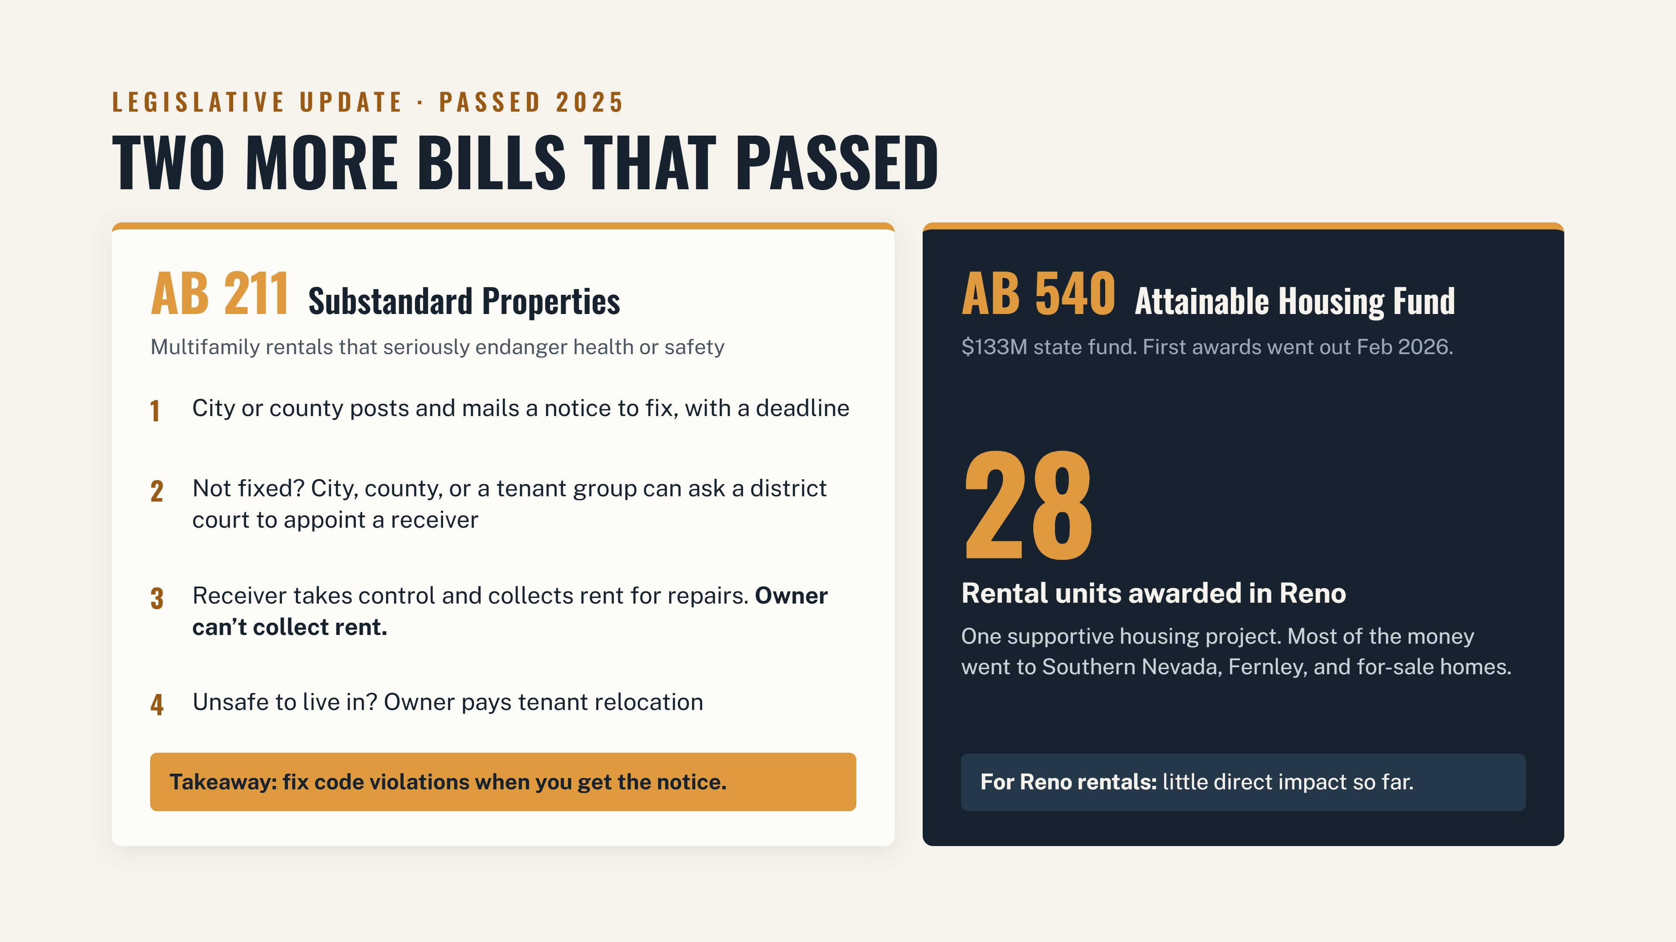

Slide 24
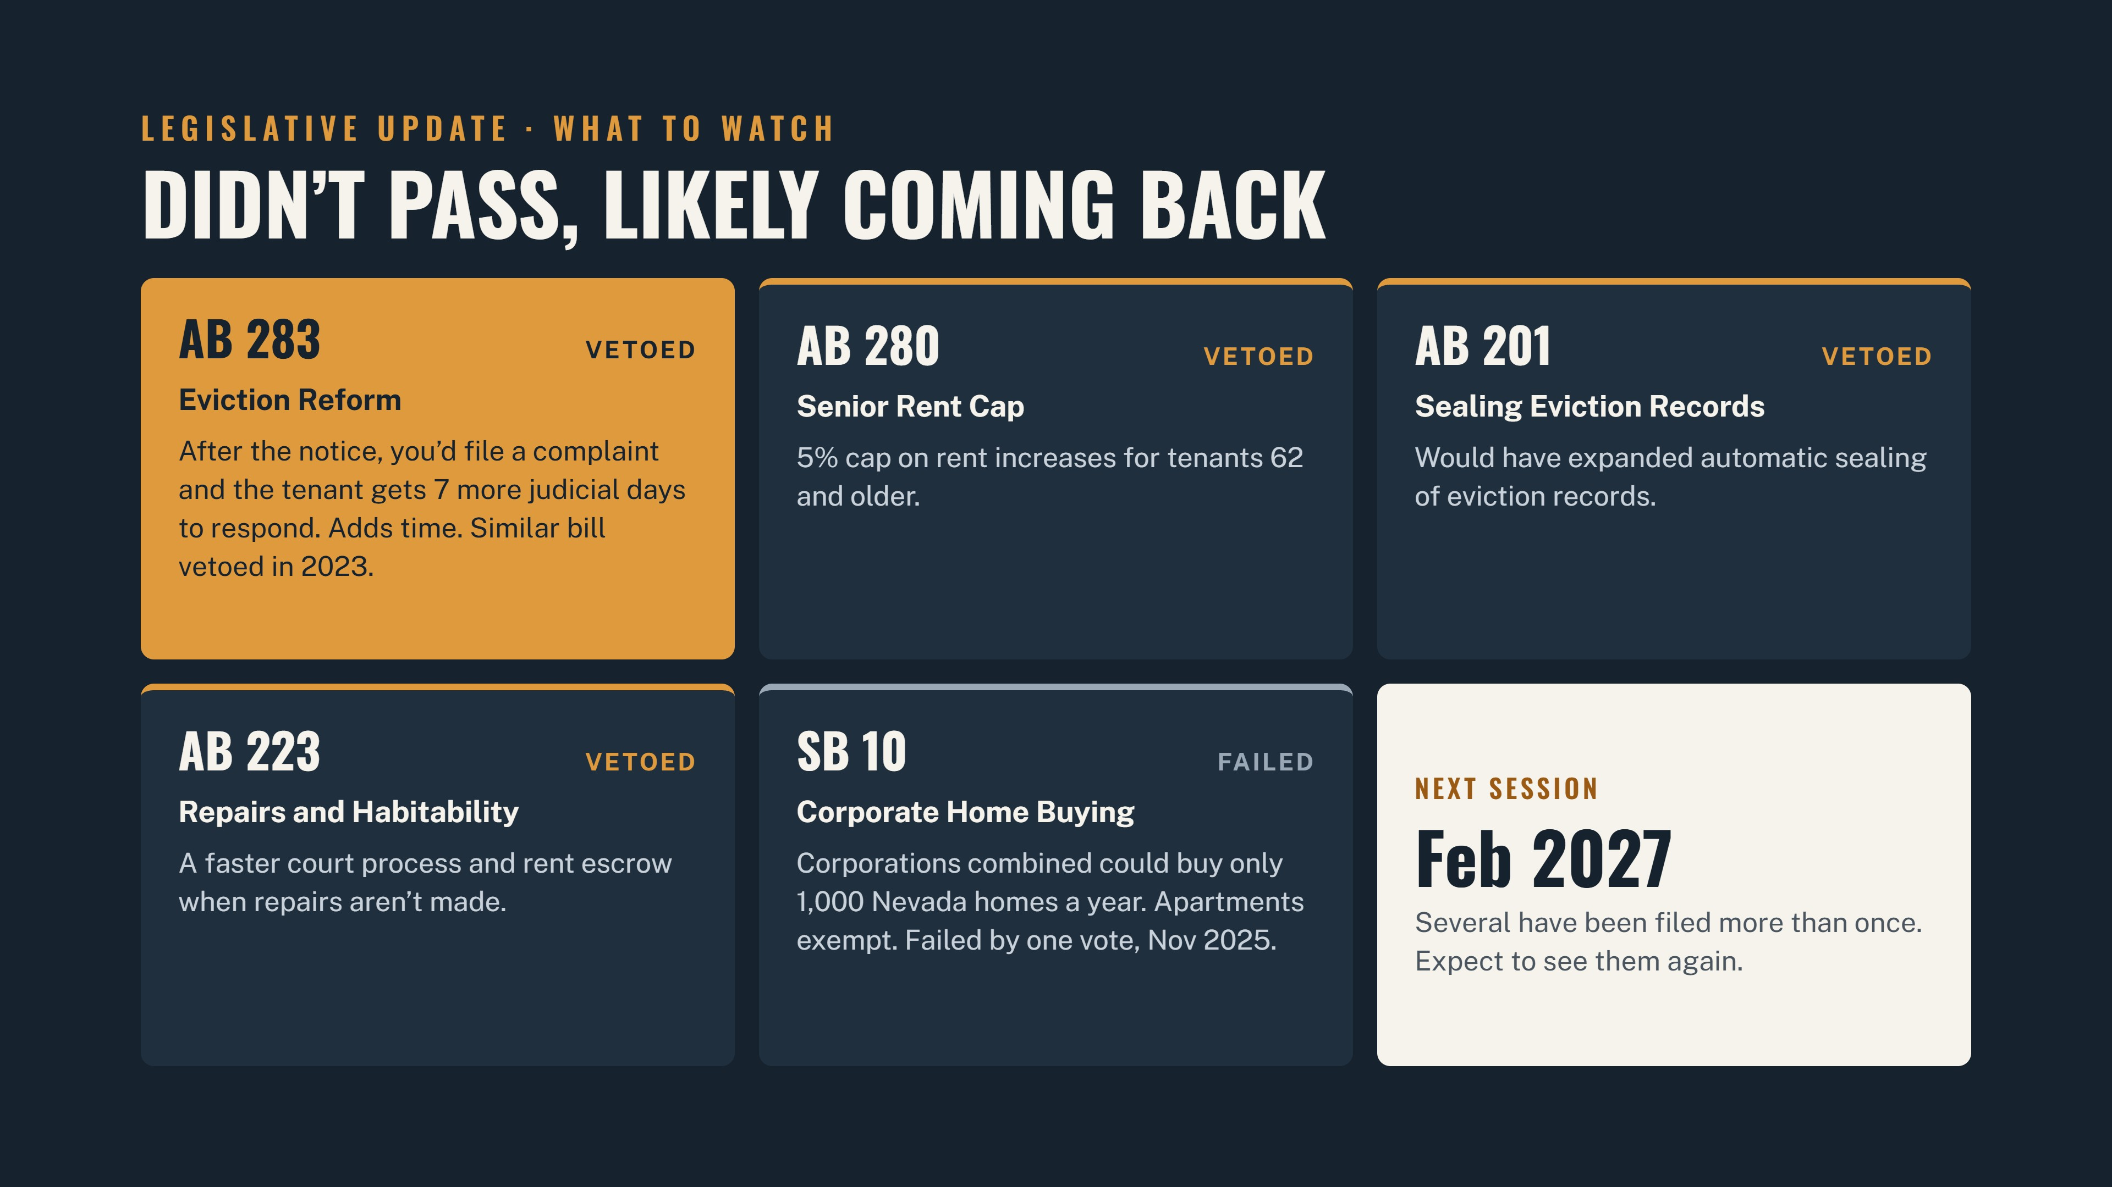

Slide 25
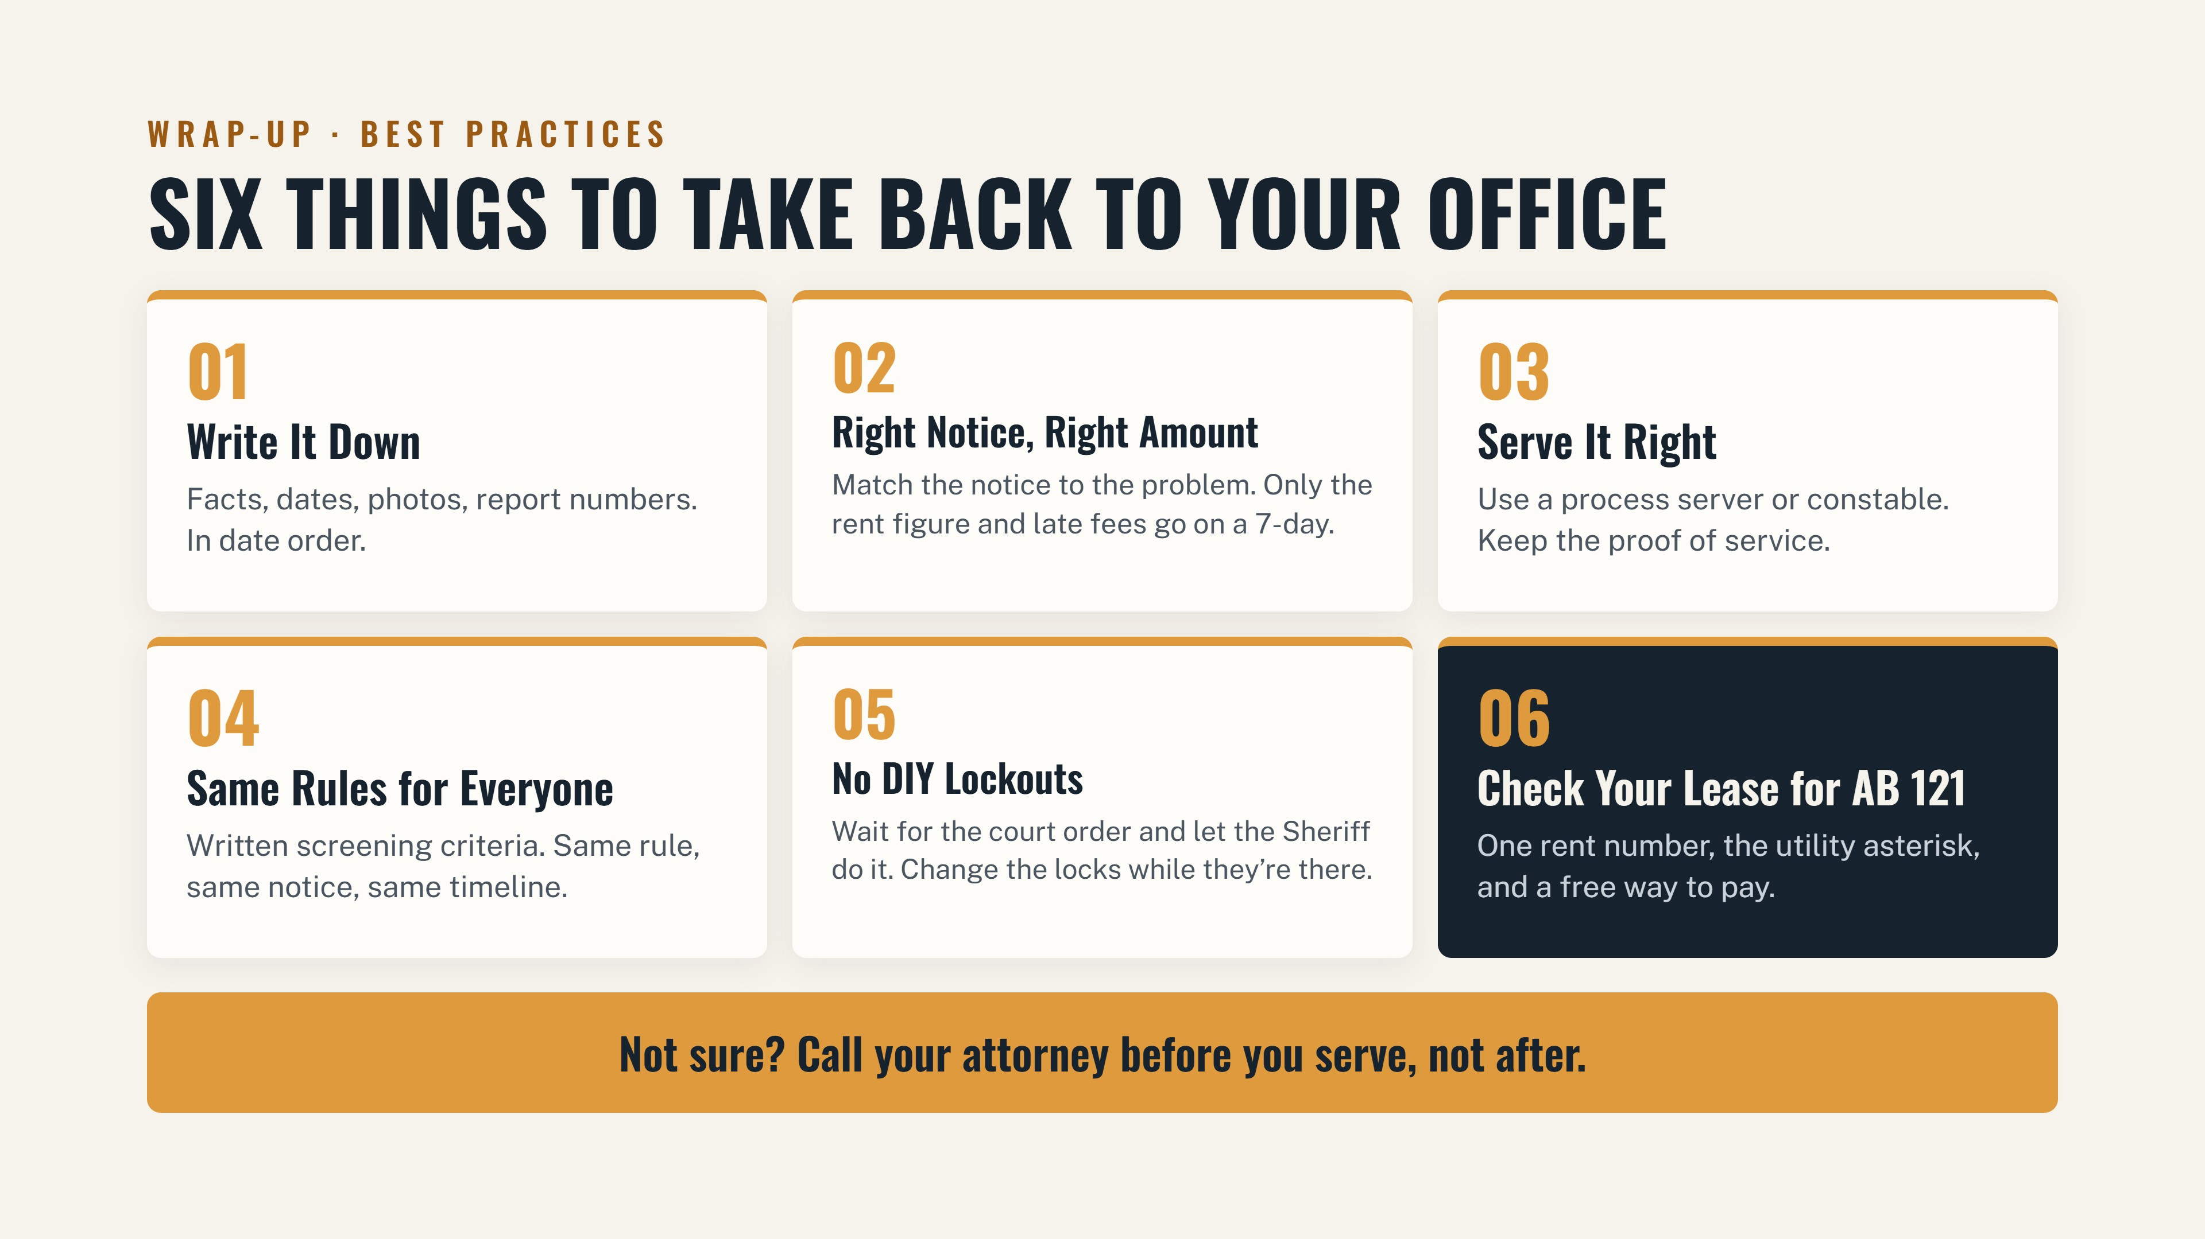

Slide 26


